Slide 1

Summer Internship Course Name
Under the guidance of:
Mr. Sumit Kumar Sah
Name: Sumit Singh
Branch: Electrical and Electronics Engineering
SIC. No. : 22BEEC36
SEMESTER: 3rd

Slide 2
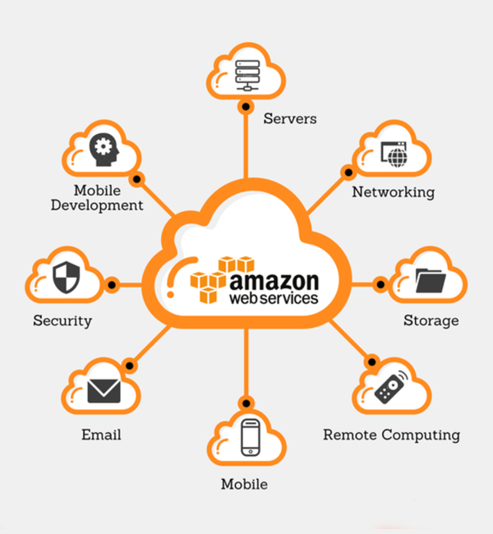
INTRODUCTION
WHAT IS AWS?
AWS or AMAZON WEB SERVICES is the Amazon’s
cloud computing platform that is widely used by
organizations of every type, size, and industry to
manage functionalities such as data backup,
virtual desktops, software development and
customer-facing web applications. AWS is designed
to allow application providers to quickly and securely
host your applications.
WHAT IS CLOUD COMPUTING?
Cloud computing is the on-demand availability of computer system resources, especially data storage and computing power, without direct active management by the user.

Slide 3
OBJECTIVES
To understand the basic concepts of AWS and Cloud Computing.
To understand how an industry works .
To get practical experience on several topics.
Gaining practical knowledge of some examples of industrial scenarios, shared by industrial experts.
To be able to create and handle cloud-based infrastructure.

Slide 4

CONTENTS OF THE PROGRAM
IT Process Management
Introduction to Networking
Introduction to Cloud Computing and AWS
Setting up AWS Account
Block Storage, EBS Lab, EFS and EPHEMERAL
Instance type and pricing model and AWS IP
Elastic IP, Open VPN, Webserver Deployment
IAM User, AWS CLI, IAM Role in AWS
VPC Lab, VPC Peering and VPC Endpoint
S3 Deep Dive
Application Load Balancer, Cloud Watch
Virtual Hosting and Auto-Scaling Lab
RDS,Route53,Beanstalk,Cloud front, Cloud formation
AWS MGN
Introduction to AWS Data Analytics
Glue, Athena and Lambda

Slide 5
METHODOLOGY
Basics of cloud computing and AWS's role in the industry.
Engaging in hands-on labs for real-time experience to reinforce theoretical knowledge.
Analyzing case studies showcasing its applications in industrial scenarios.
Encouraging participants to apply AWS skills in their own projects.
Regular assessments to gauge understanding and track progress.
Guidance on AWS certifications for future career development.
Connecting with a community of AWS learners and sharing experiences and insights.
Collecting feedback for course improvement and offering real-time support during the course.

Slide 6
Projects Done
The task was given to create a VPC (Virtual Private Cloud) which contained two subnets -Public subnet and Private subnet.
The public subnet should contain atleast 2 web servers and the private subnet contained database server installed with any latest version of MySQL.
The public subnet should be configured with Load Balancer (including domain name and SSL certificate) and should be mapped ROUTE53.
Auto-scaling should be configured with the server in public subnet and an Open VPN set-up should also be done here.

Slide 7
CONCLUSION
Acquire a comprehensive understanding of the ever-evolving realm of cloud computing.
Explore practical facets crucial for emerging Aws engineers in our hands-on training.
Tailored for industry relevance, this program is meticulously crafted to nurture essential skills for Aws professionals.
Emphasizing Aws-native knowledge and services, it provides a solid foundation for pursuing certifications like Aws cloud practitioner and more of it.
Our focus on practical aspects ensures seamless integration into the Aws landscape.
The program lays the groundwork for aspiring Aws Solutions Architects, fostering the expertise needed for success.

